Slide 1
DESCRIBING CITIES

Slide 2
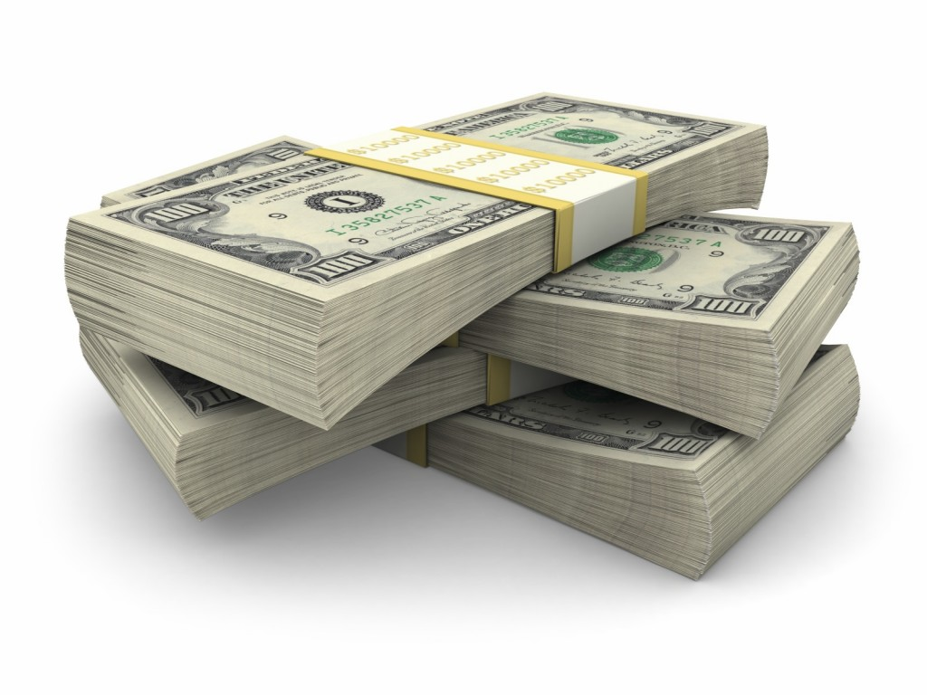
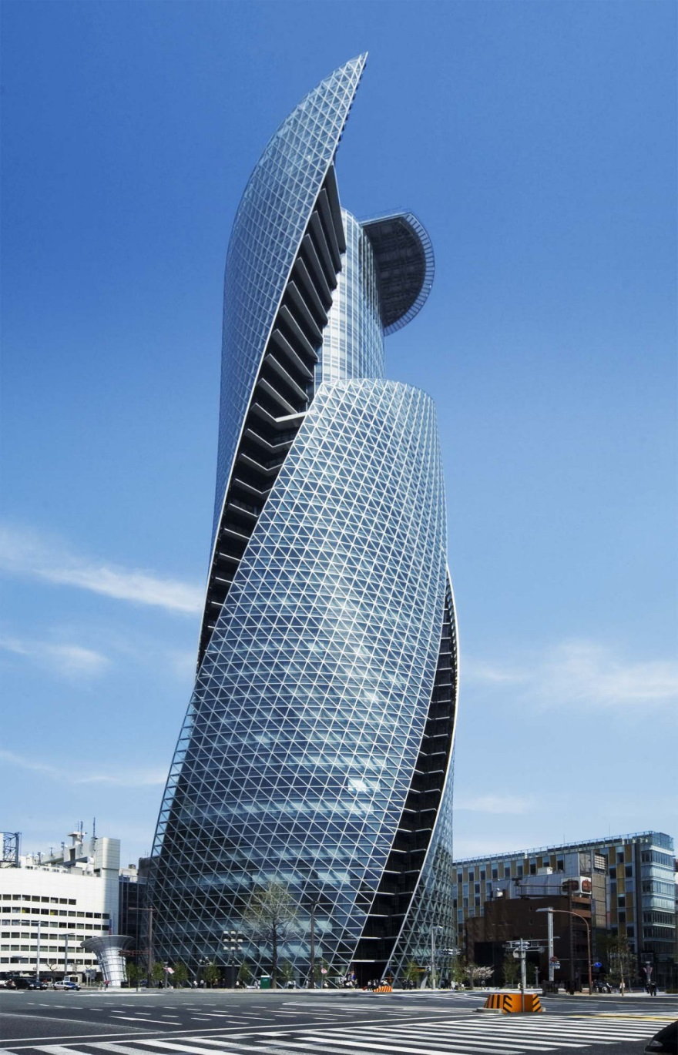
Modern
Expensive

Slide 3
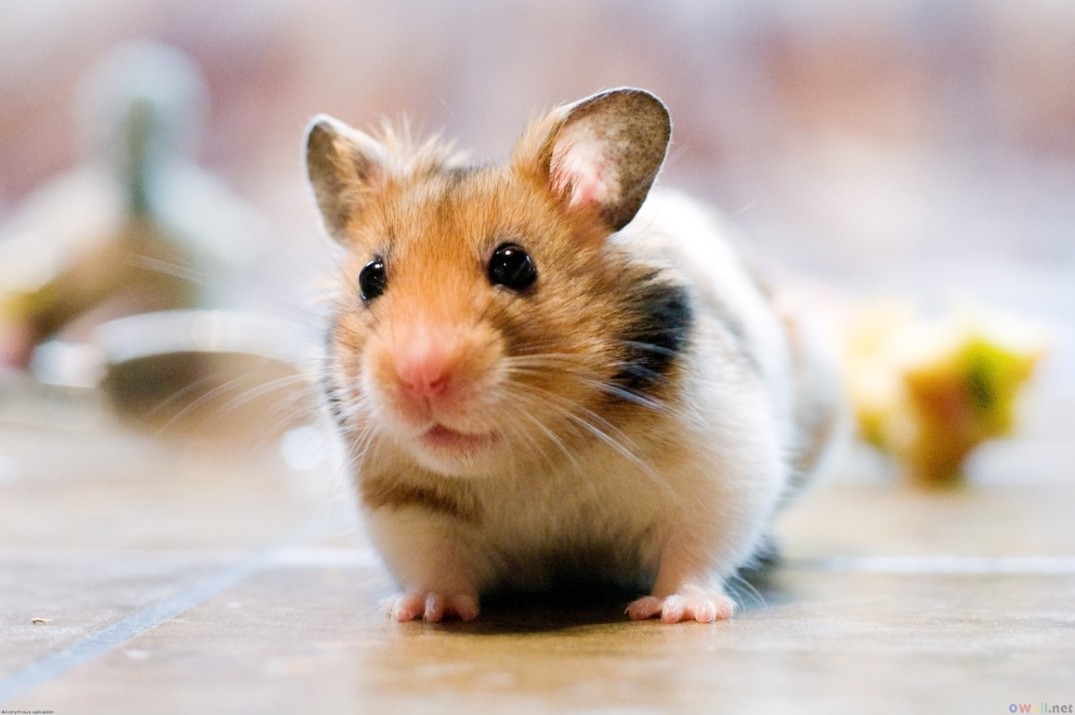
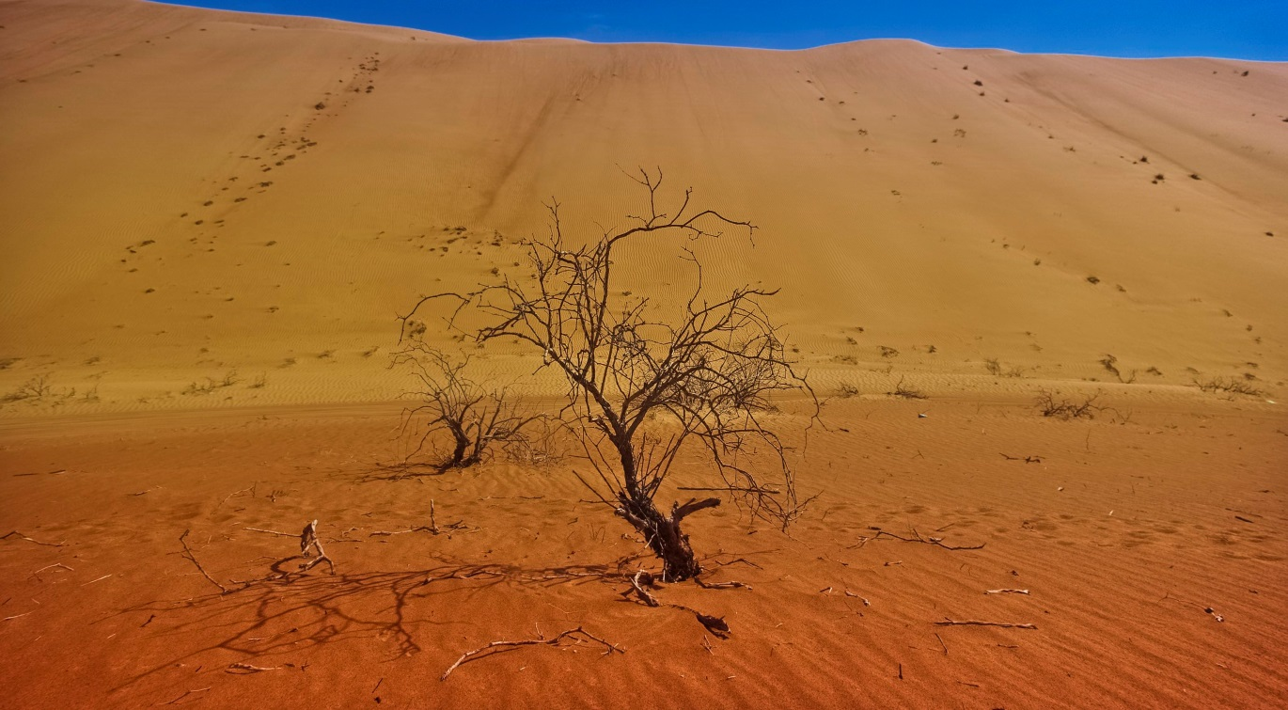
Small
Deserted /
Empty

Slide 4
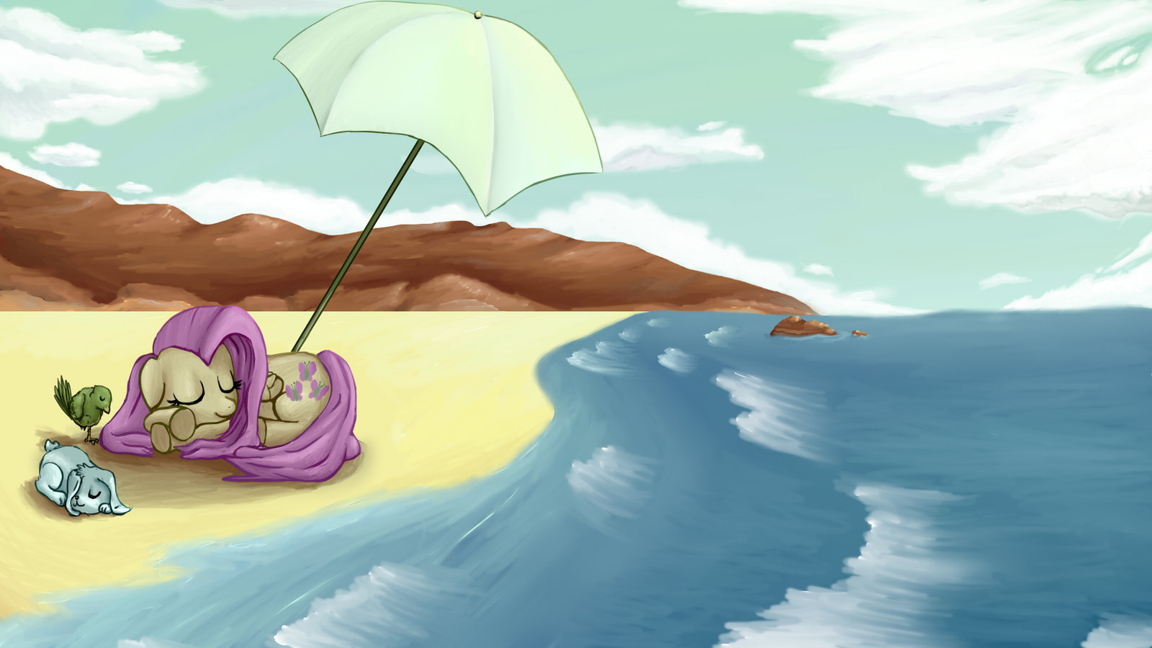
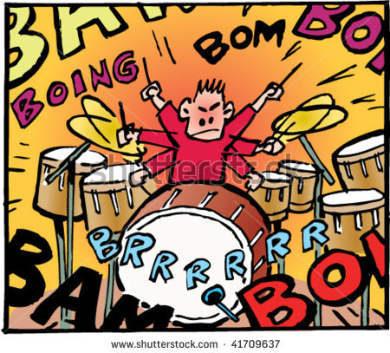
Quiet
Noisy

Slide 5
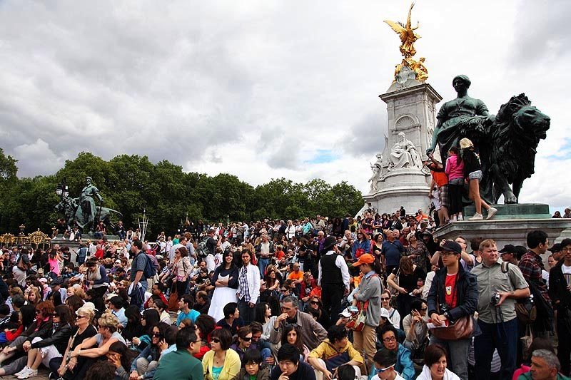

Crowded
dangerous

Slide 6


Safe
Inexpensive

Slide 7
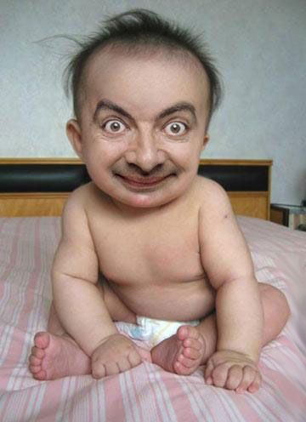

Old
Ugly

Slide 8
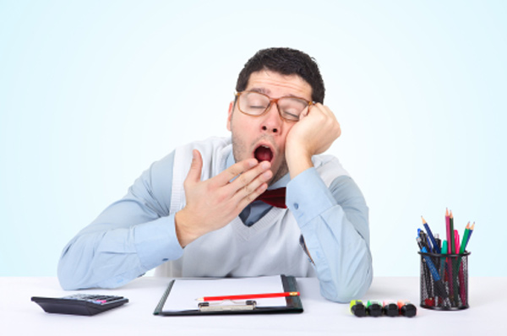

Boring
Interesting

Slide 9
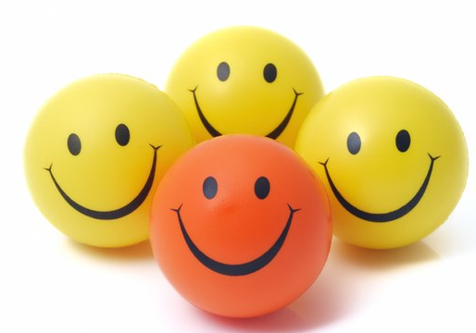

Fun

Slide 10
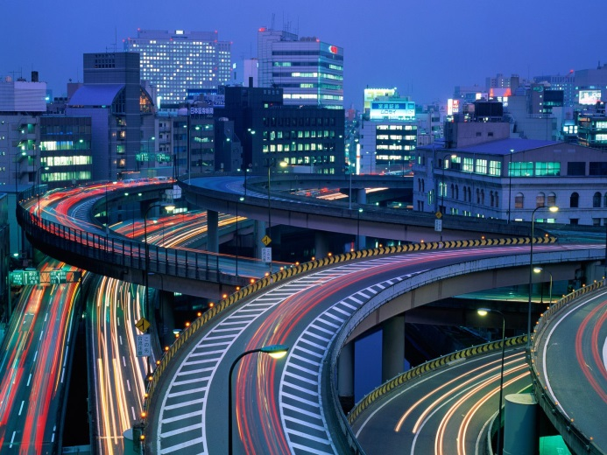
CONSTRUCTING SENTENCES
Verb TO BE
+
Adjective
am
interesting
is
modern
are
expensive
Tokyo
is
modern

Slide 11
When two adjectives are positive
Paris is beautiful. Paris is fun.
Paris is beautiful and fun.
When one adjective (+)/ one (-)
Paris is modern. Paris is expensive.
Paris is modern but expensive.

Slide 12

MORE ELABORATED SENTENCES
Peru is a wonderful country.
People are friendly and nice.
Supermarkets are big and clean.
The public transportation is bad.
The cities are small and old.

Slide 13
YES / NO QUESTIONS.
Lima
is
Lima
inexpensive
?
The beaches
are
the beaches
clean
?
ANSWERS
Yes, it is
No, it isn’t. It is …
No, they aren’t. They’re…
Yes, they are

Slide 14
Change the sentences into questions
My house is big.
London is quiet and peaceful.
The restaurants are very clean.
Buenos Aires is old but beautiful.
New York is a famous city.

